Slide 1
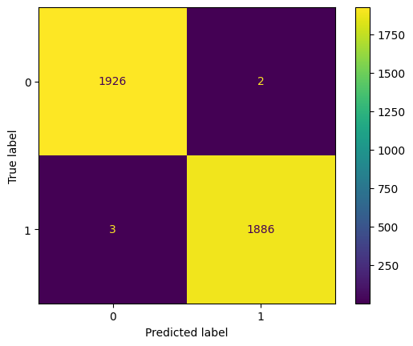
Machine Learning Model Outcomes
Executive Summary Report Prepared by Tik Tok Data Team
The TikTok Data Team is looking to develop a machine learning to assist with the classification of videos with the choice of claims or opinions. After previously investigating the available data, is is revealed that video engagement levels highly correlated with claim status. The data team is confident that the resulting model will meet the performance requirements.
TikTok videos receive a large number of user reports for a variety of different reasons. Not every every reported video can be reviewed by a human moderator.
Videos that make claims are much more likely to contain content that violates the platform’s terms of service, as compared to videos that make opinions. Tik Tok is seeking a method to identify videos that make claims to prioritize them for review.
The Tik Tok Data Team built two tree-based classification models. Both of these models were used to predict on a held-out validation database, and the final model chosen was decided by the model with the highest recall score.
The final model was then used to score a test dataset to estimate future performance.
Confusion matrix for the champion RF model on test holdout data shows only five misclassified samples out of 3,817.
Both model architectures—random forest (RF) and XGBoost—performed exceptionally well.
The random forest (RF) model had a greater recall score (0.995) and was selected as champion.
Performance on the test holdout data yielded almost perfect scores, with only five misclassified samples out of 3,817.
Subsequent analysis indicated that, as expected, the primary predictors were all related to video engagement levels, with video view count, like count, share count, and download count accounting for nearly all predictive signal in the data. With these results, it can be concluded that videos with higher user engagement levels were much more likely to be claims. The fact that no opinion video had more than 10,000 views confirms this.
The model performed exceptionally well on the test holdout data.
Before deploying the model, the data team recommends further evaluation using additional subsets of user data. Additionally, the data team recommends monitoring the distributions of video engagement levels. This is to ensure that the model remains robust to fluctuations in its most predictive features.

